Slide 1


Slide 2
RSS Teamchat Integration

Slide 3


RSS Teamchat Integration
RSS Teamchat Integration will help users to filter the blogs which they want to see.
It will push notifications to users for every new news feed after certain time interval set by user directly as a chatlet on teamchat. So the problem to log-in every time is solved.

Slide 4

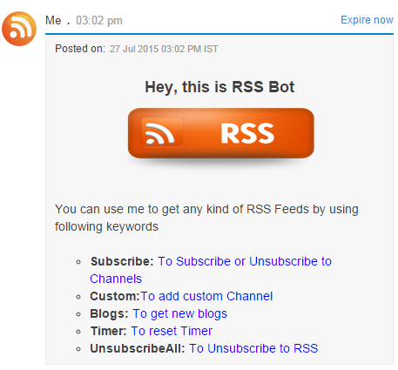
Help keyword initiates the bot and
displays the list of keyword which
can be used for getting feeds

Slide 5
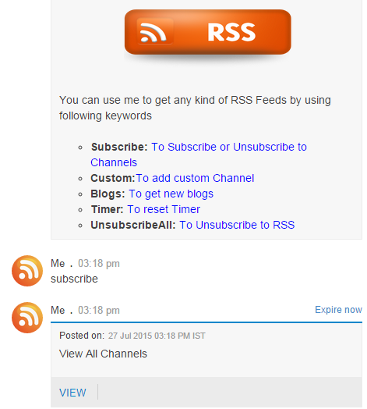
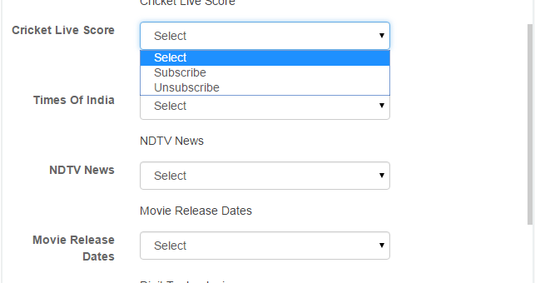
Subscribe keyword allow user to subscribe
to some of the RSS feeds

Slide 6
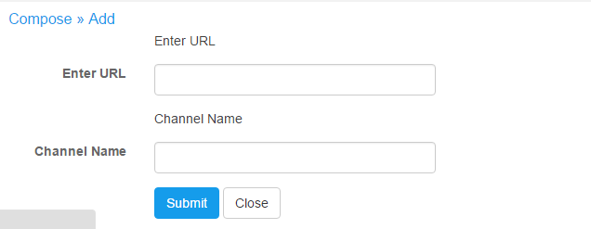
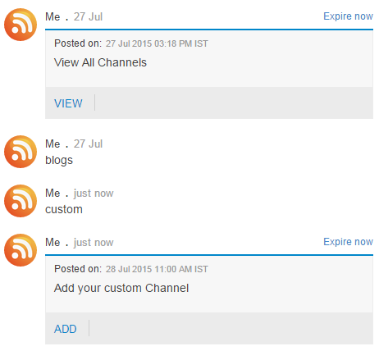
User can add any of the custom url's by just
adding the url and the channel name

Slide 7
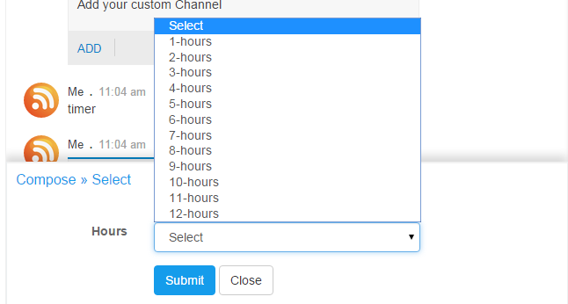
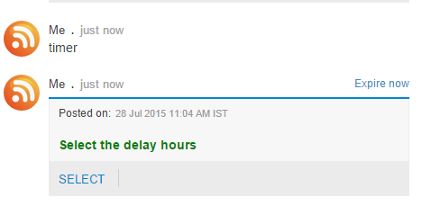

Slide 8
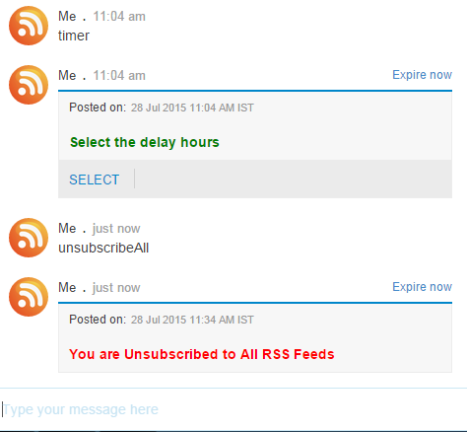
The unsubscribeAll keyword
unsubscribes from all the subscribed
channels

Slide 9
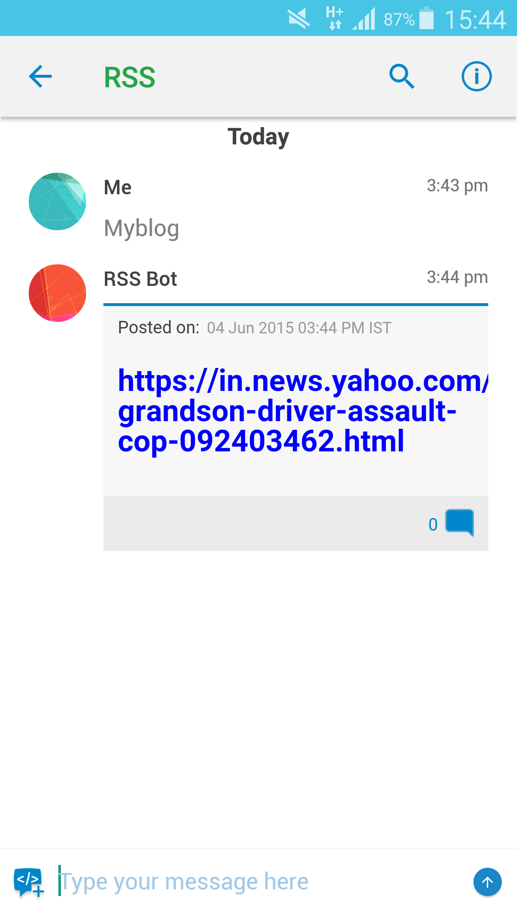
Blog keyword posts all the new
news feeds and resets the timer.

Slide 10


